Slide 1
Finite mixture models for trajectory analysis of in-hospital routine laboratory values: application as biomarkers in spinal cord injury patients
Abel Torres Espín
Master en Bioinformática y Bioestadística

Slide 2
Outline
Introduction to the clinical and biological context
Objectives and methodology
Results
Conclusions
Future work

Slide 3
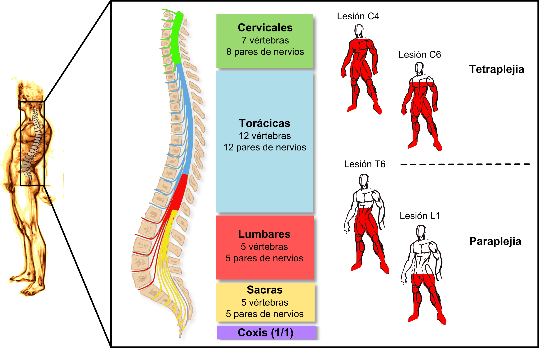
1. Introduction to the clinical and biological context
Spinal Cord Injury (SCI)
Cervical
Thoracic
Injury to the spinal cord
Lumbar
Sacrum and Coccis
Transversal plane

Slide 4
1. Introduction to the clinical and biological context
Spinal Cord Injury (SCI)
Estimated 930.000 new SCI cases in the world in 2016
Calculated prevalence of 27 million people worldwide (James et al., 2019)
Cervical
Thoracic
Injury to the spinal cord
Lumbar
Sacrum and Coccis
Transversal plane

Slide 5
1. Introduction to the clinical and biological context
Spinal Cord Injury (SCI)
Primary clinical features determining presentation
Neurological level of injury
Amount of damaged tissue
Damage location
Complex and heterogeneous clinical presentation
Difficult acute diagnostic and prognostic by clinical assessment
Cervical
Thoracic
Other factors contributing to population heterogeneity
Demographics
Socioeconomics
Genetics
Medical history
Comorbidities
Injury temporal evolution
Injury to the spinal cord
Potential objective measures of pathology
Spinal cord MRI
Blood biomarkers
Cerebrospinal fluid biomarkers
Vital signs
Lumbar
Sacrum and Coccis
Transversal plane

Slide 6
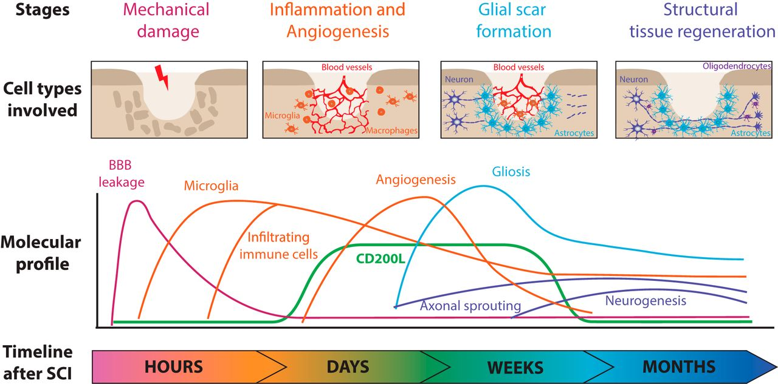
1. Introduction to the clinical and biological context
Spinal Cord Injury (SCI)
Cervical
Thoracic
Lumbar
Sacrum and Coccis
Ruslan Rust and Julia Kaiser, J Neuroscience 2017

Slide 7
1. Introduction to the clinical and biological context
Can we proxy the dynamic pathophysiological events after SCI from changes in blood markers?

Slide 8
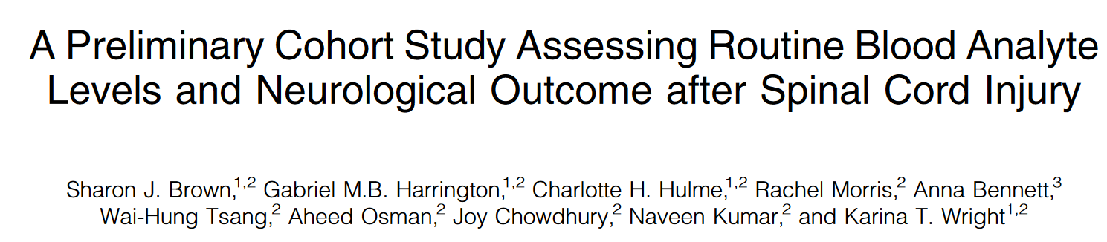
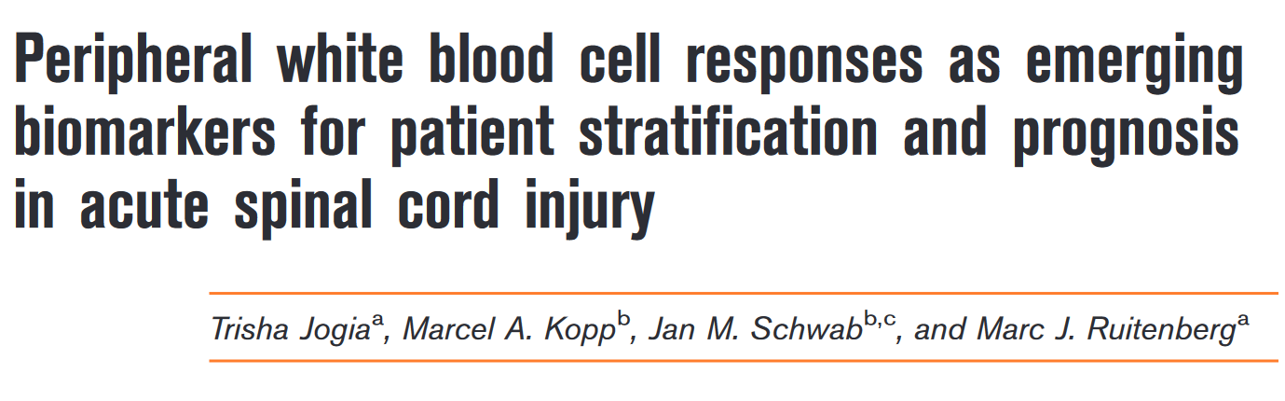
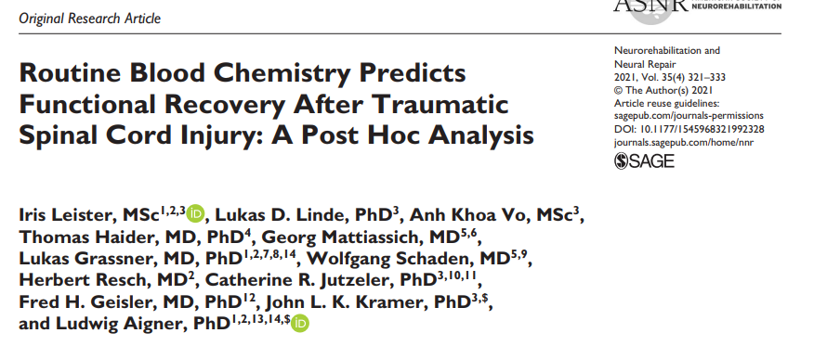
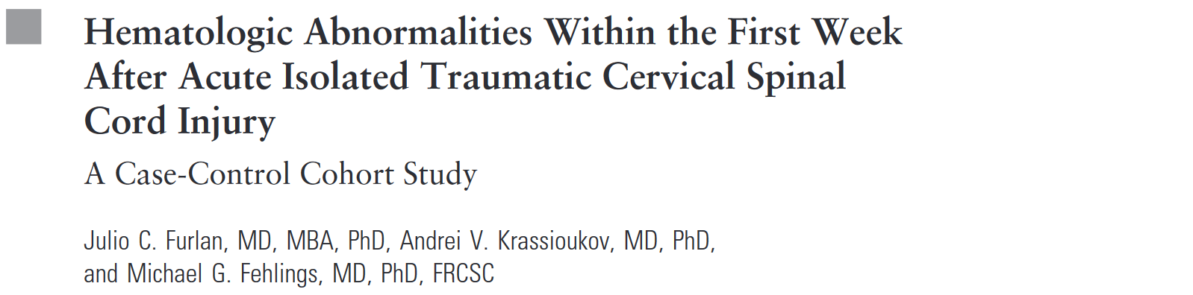
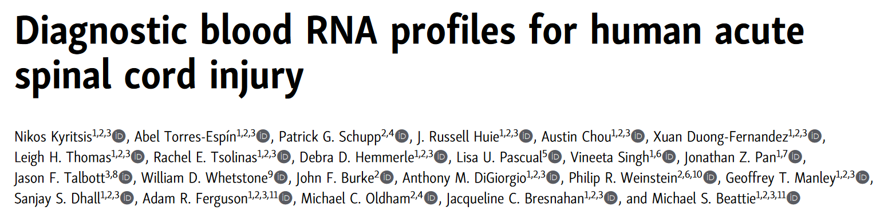
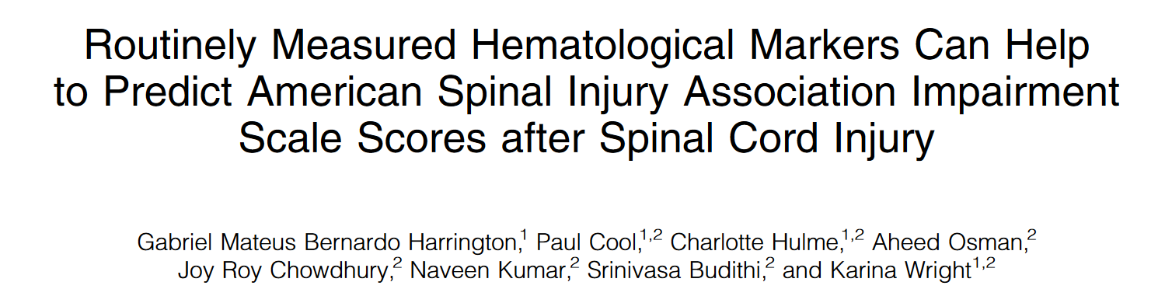
1. Introduction to the clinical and biological context
Can we proxy the dynamic pathophysiological events after SCI from changes in blood markers?

Slide 9
1. Introduction to the clinical and biological context
Unsolved analytical challenges

Slide 10
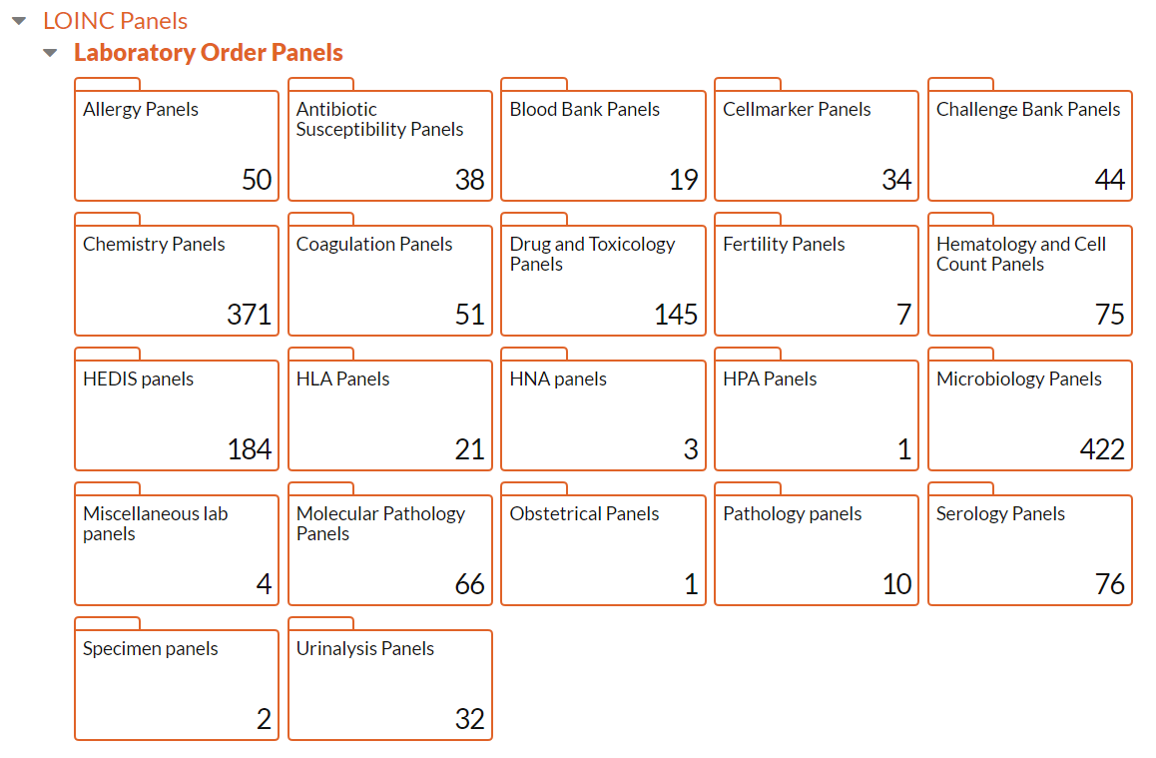
1. Introduction to the clinical and biological context
Unsolved analytical challenges
Multidimensionality
https://loinc.org/panels/category

Slide 11
1. Introduction to the clinical and biological context
Unsolved analytical challenges
Multidimensionality
Temporality

Slide 12
1. Introduction to the clinical and biological context
Unsolved analytical challenges
Multidimensionality
Temporality
Non-linearity

Slide 13
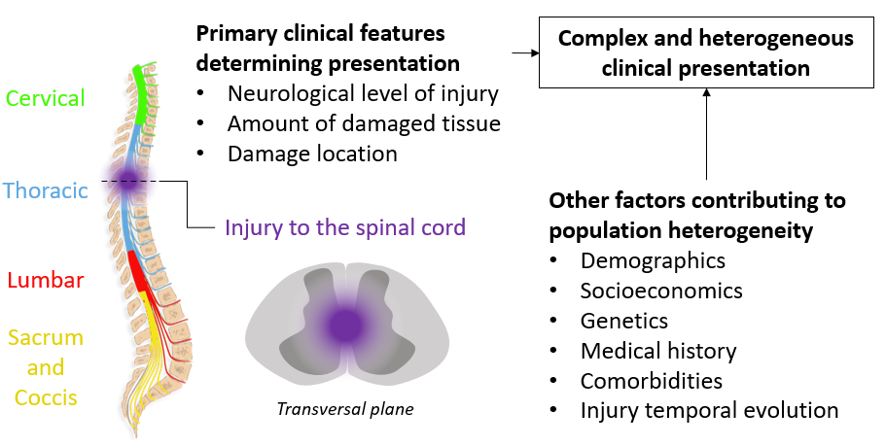
1. Introduction to the clinical and biological context
Unsolved analytical challenges
Multidimensionality
Temporality
Non-linearity
Heterogeneity

Slide 14
2. Objectives and methodology
What can we do about it?
The main hypothesis is that non-linear multi trajectories of several blood markers are proxies for SCI pathophysiology and can be used as biomarkers for patient outcome

Slide 15
2. Objectives and methodology
What can we do about it?
The main hypothesis is that non-linear multi trajectories of several blood markers are proxies for SCI pathophysiology and can be used as biomarkers for patient outcome
Observation
Measure
Missing value
t₁
t₂
t₃
t₄
t₅
Time

Slide 16
2. Objectives and methodology
What can we do about it?
The main hypothesis is that non-linear multi trajectories of several blood markers are proxies for SCI pathophysiology and can be used as biomarkers for patient outcome
Subject latent trajectory
Observation
Measure
Missing value
t₁
t₂
t₃
t₄
t₅
Time

Slide 17

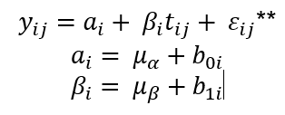




2. Objectives and methodology
What can we do about it?
The main hypothesis is that non-linear multi trajectories of several blood markers are proxies for SCI pathophysiology and can be used as biomarkers for patient outcome
Subject latent trajectory
Mean latent trajectory
Observation
Linear mixed model
Measure
$$μ_{β}$$
$$β$$
$$α$$
$$μ_{α}$$
Missing value
t₁
t₂
t₃
t₄
t₅
t₁
t₂
t₃
t₄
t₅
Time
Time

Slide 18
2. Objectives and methodology
What can we do about it?
The main hypothesis is that non-linear multi trajectories of several blood markers are proxies for SCI pathophysiology and can be used as biomarkers for patient outcome
Subject latent trajectory
Mean latent trajectory
Observation
Measure
$$μ_{β}$$
$$β$$
$$α$$
$$μ_{α}$$
Missing value
t₁
t₂
t₃
t₄
t₅
t₁
t₂
t₃
t₄
t₅
t₁
t₂
t₃
t₄
t₅
Time
Time
Time

Slide 19
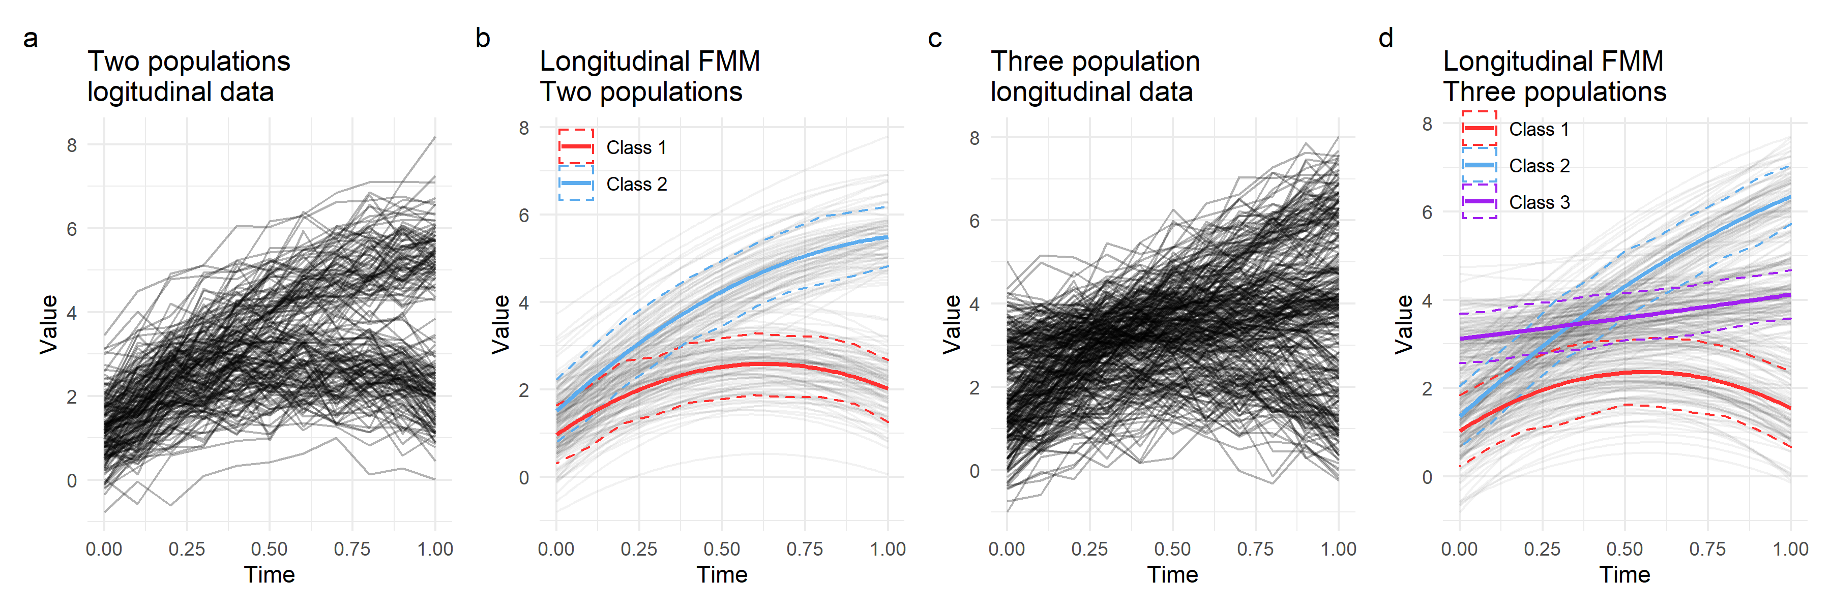
2. Objectives and methodology
Multi-class trajectory: probabilistic clustering of longitudinal data

Slide 20

2. Objectives and methodology
Multi-class trajectory: probabilistic clustering of longitudinal data

Slide 21
2. Objectives and methodology
Multi-class trajectory: probabilistic clustering of longitudinal data
Longitudinal Finite Mixture Model (FMM)
lcmm R package

Slide 22









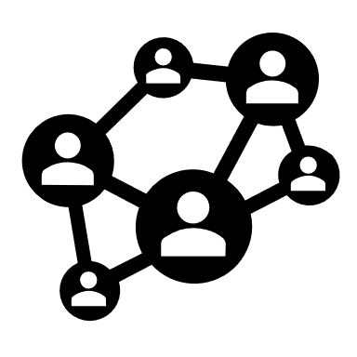

PhysioNet.org
2. Objectives and methodology
MIMIC. Electronic Health Records (EHR) databases from the Harvard Beth Israel Deaconess Medical Center hospital in Boston, US.
MIMIC-III: 46,520 unique patients from 2001 to 2012
MIMIC-IV: 382,278 unique patients from 2008 to 2019
Data extraction, cohort building and exploration
Data structure
Database
Data harmonization
Trajectory modeling
MIMIC-III
ML prediction
MIMIC-IV

Slide 23
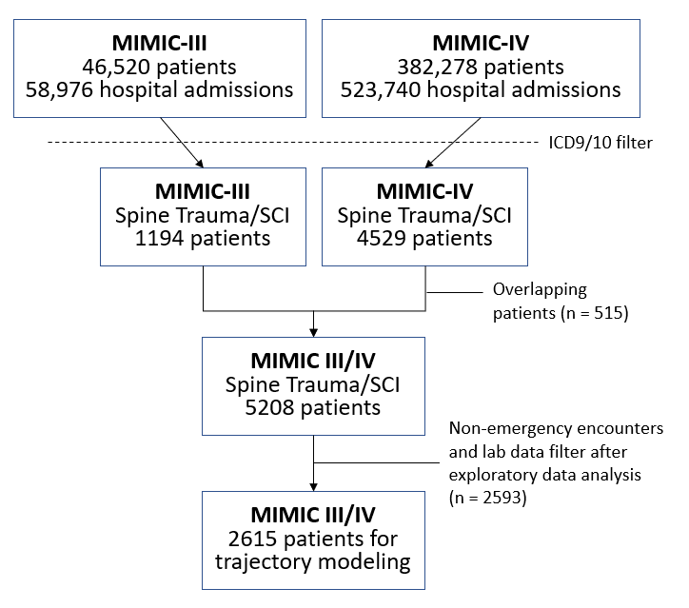
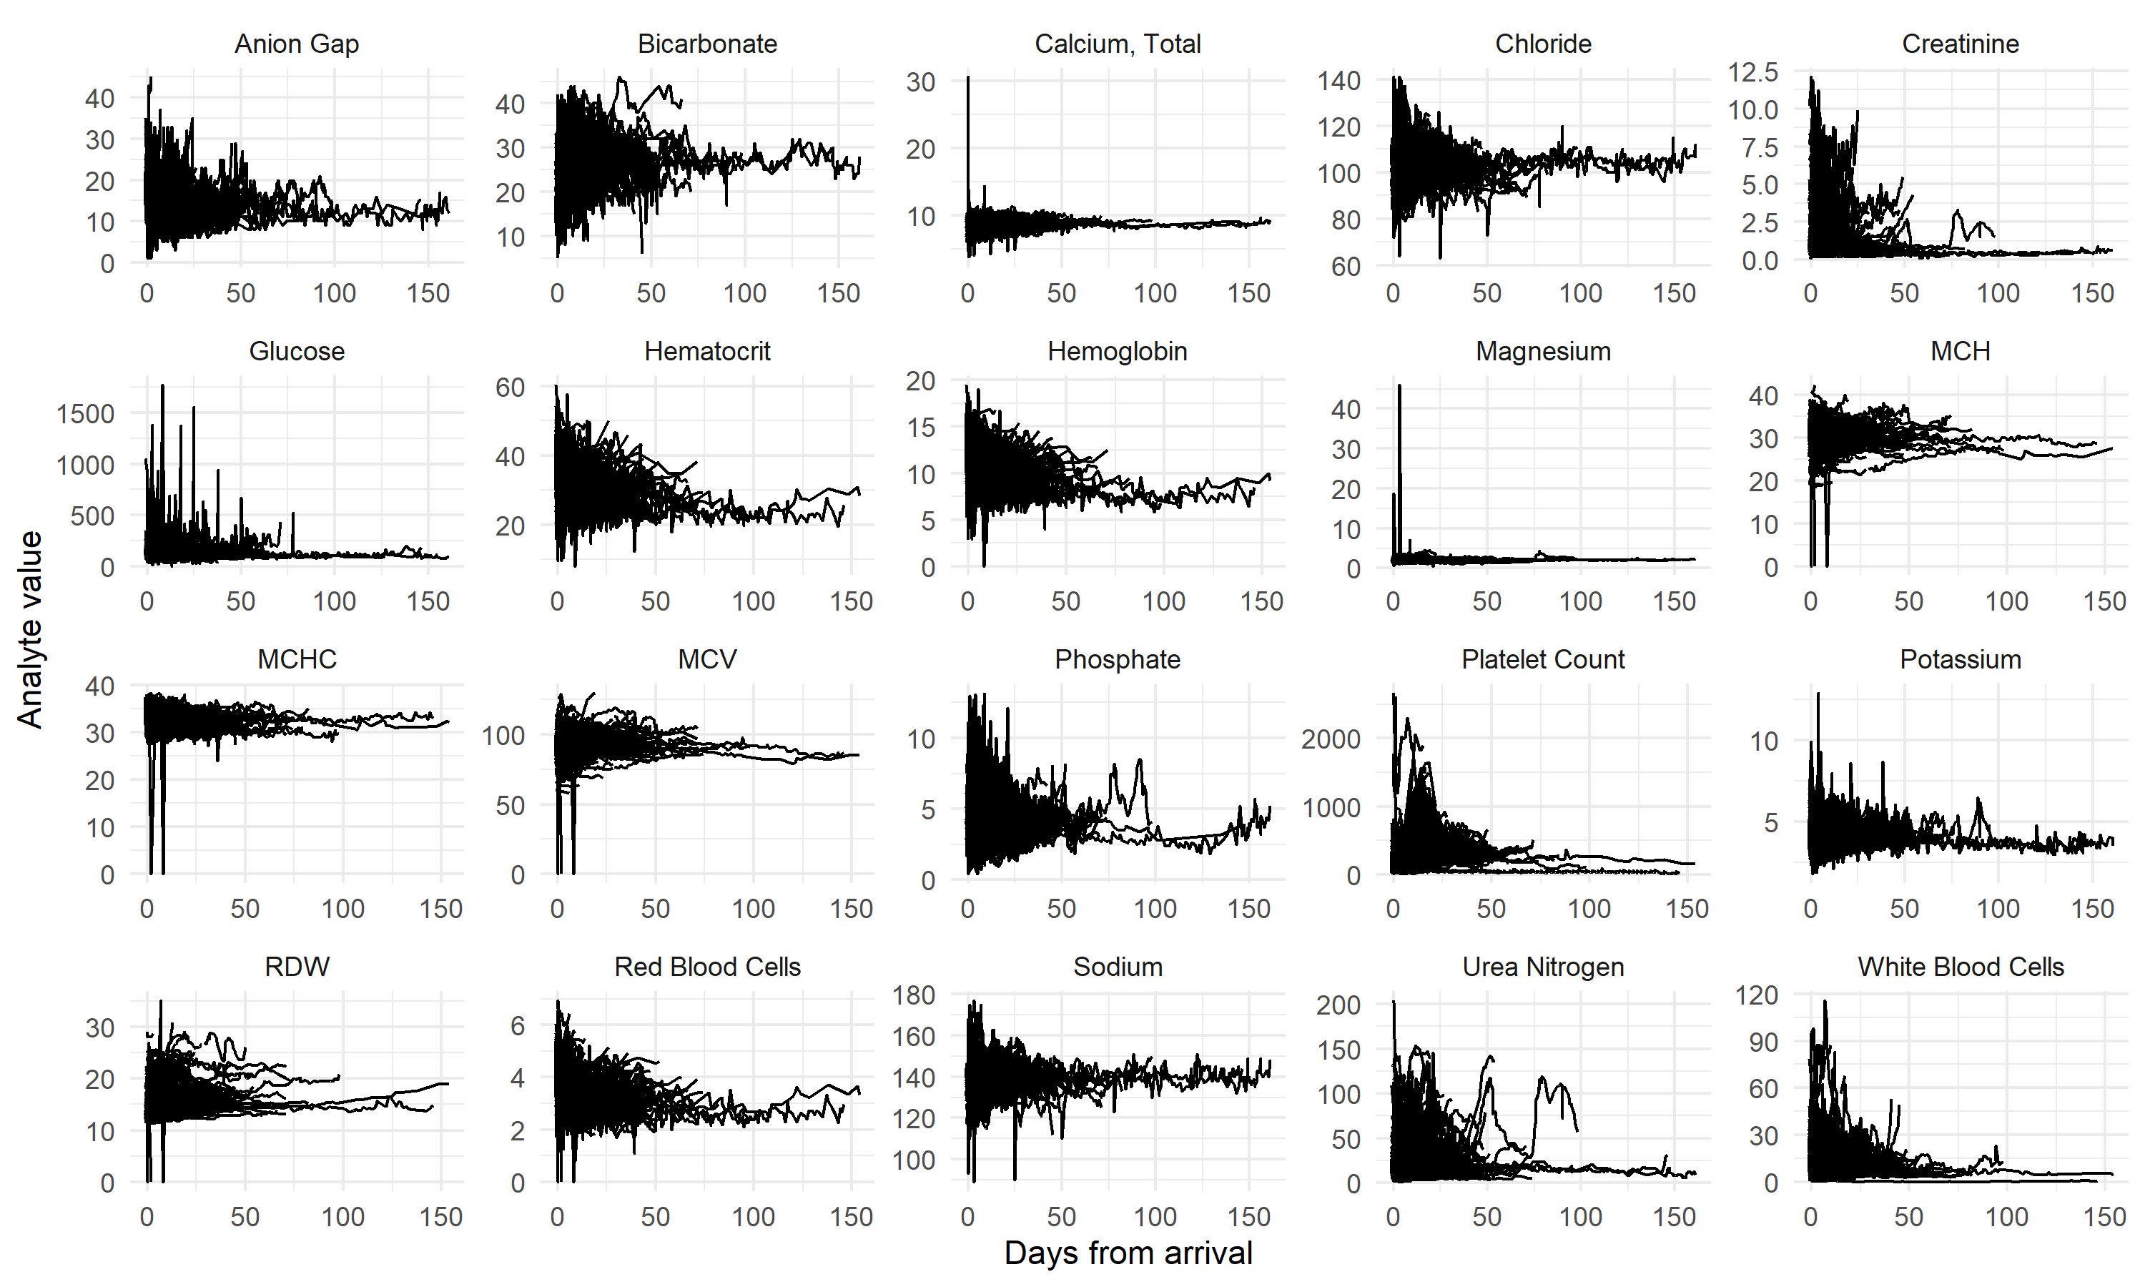
3. Results
SCI Fracture (n = 382)
SCI noFracture (n = 125)
Spine Trauma Control (n = 2108)
413 distinct blood markers
Modeling set (the 20 most common)

Slide 24
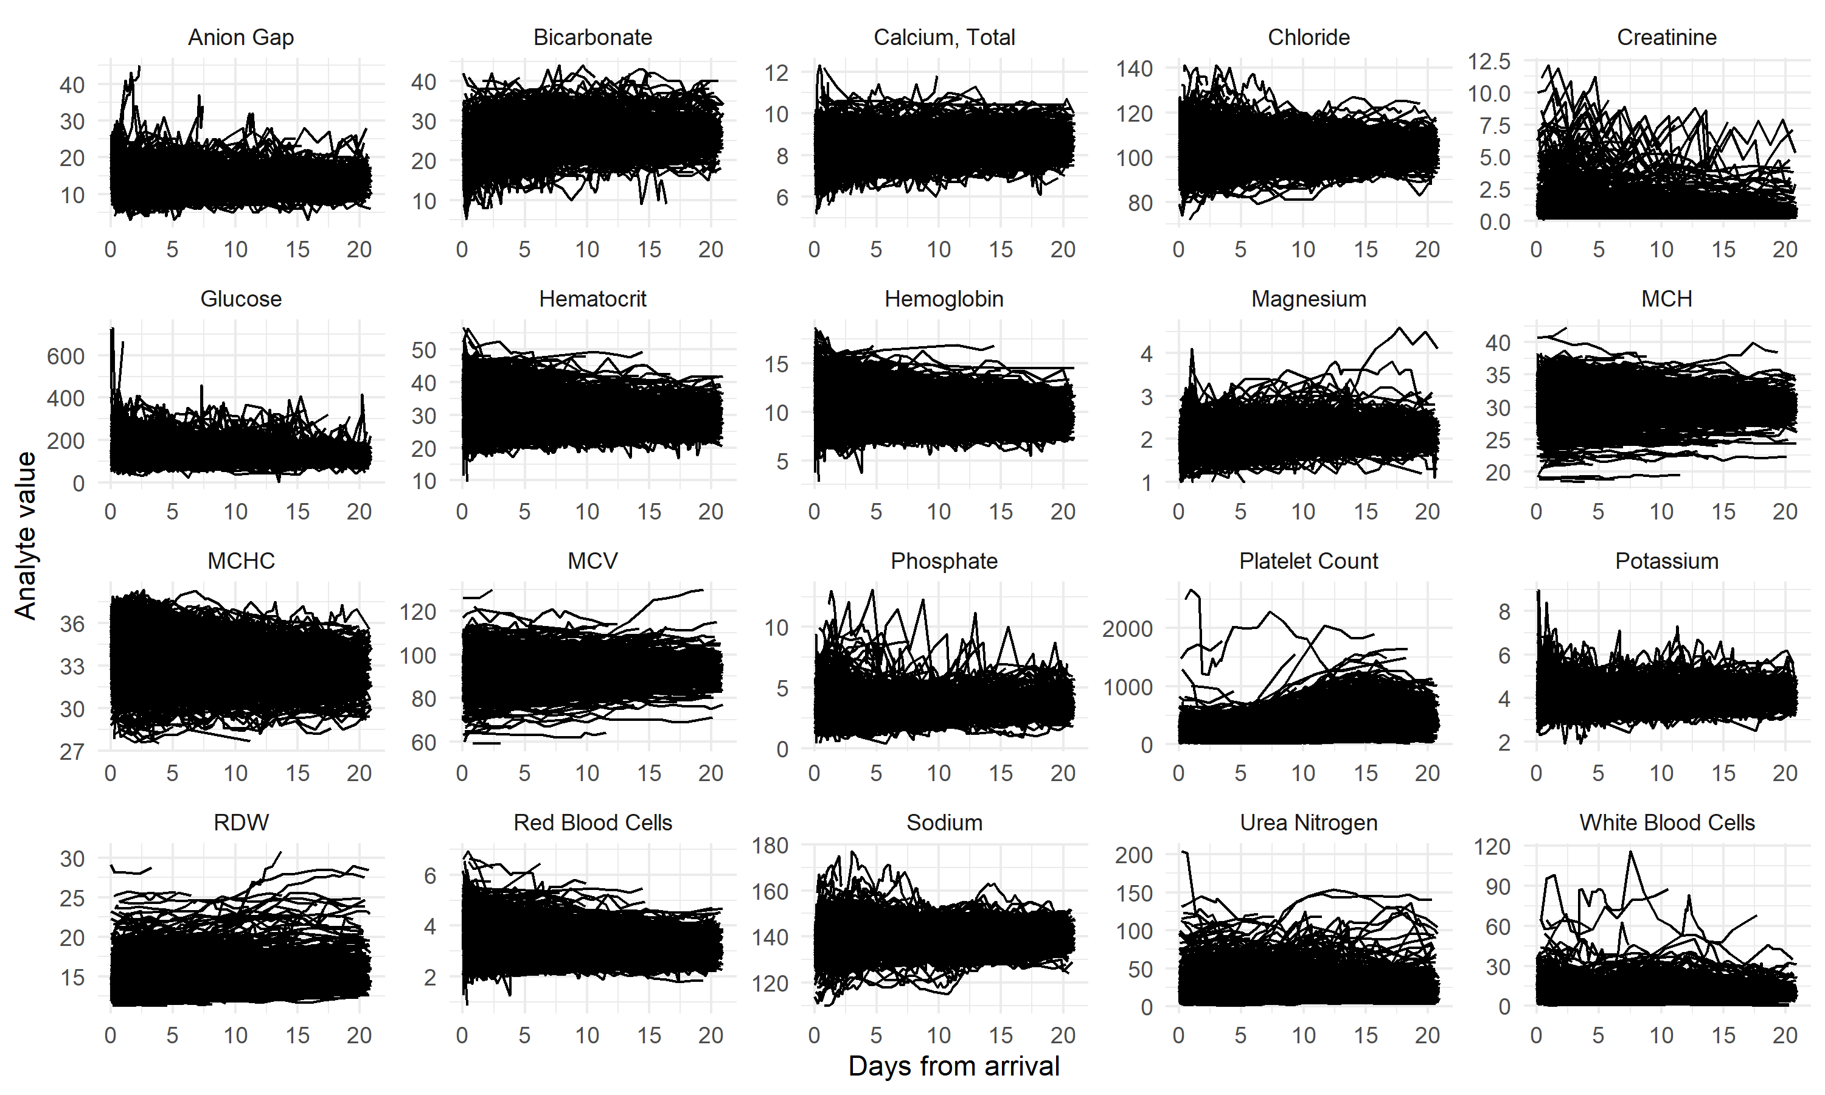
3. Results
Exploratory grid search for modeling hyperparameters
Number of trajectory classes
Type of link function (Gaussian, non-Gaussian)
Polynomial degree
2 step modeling (1022 models)
Latent Class Growth Analysis (LCGA). No random effects (no individual trajectory)
Growth Mixture model. Random effects
Goodness-of-fit metrics (BIC, ICL, APPA)
Final model per analyte

Slide 25
3. Results
Exploratory grid search for modeling hyperparameters
Number of trajectory classes
Type of link function (Gaussian, non-Gaussian)
Polynomial degree
2 step modeling (1022 models)
Latent Class Growth Analysis (LCGA). No random effects (no individual trajectory)
Growth Mixture model. Random effects
Goodness-of-fit metrics (BIC, ICL, APPA)
Final model per analyte
Computational time: ~7 days parallelized on 15 i9 cores and 32Gb RAM

Slide 26
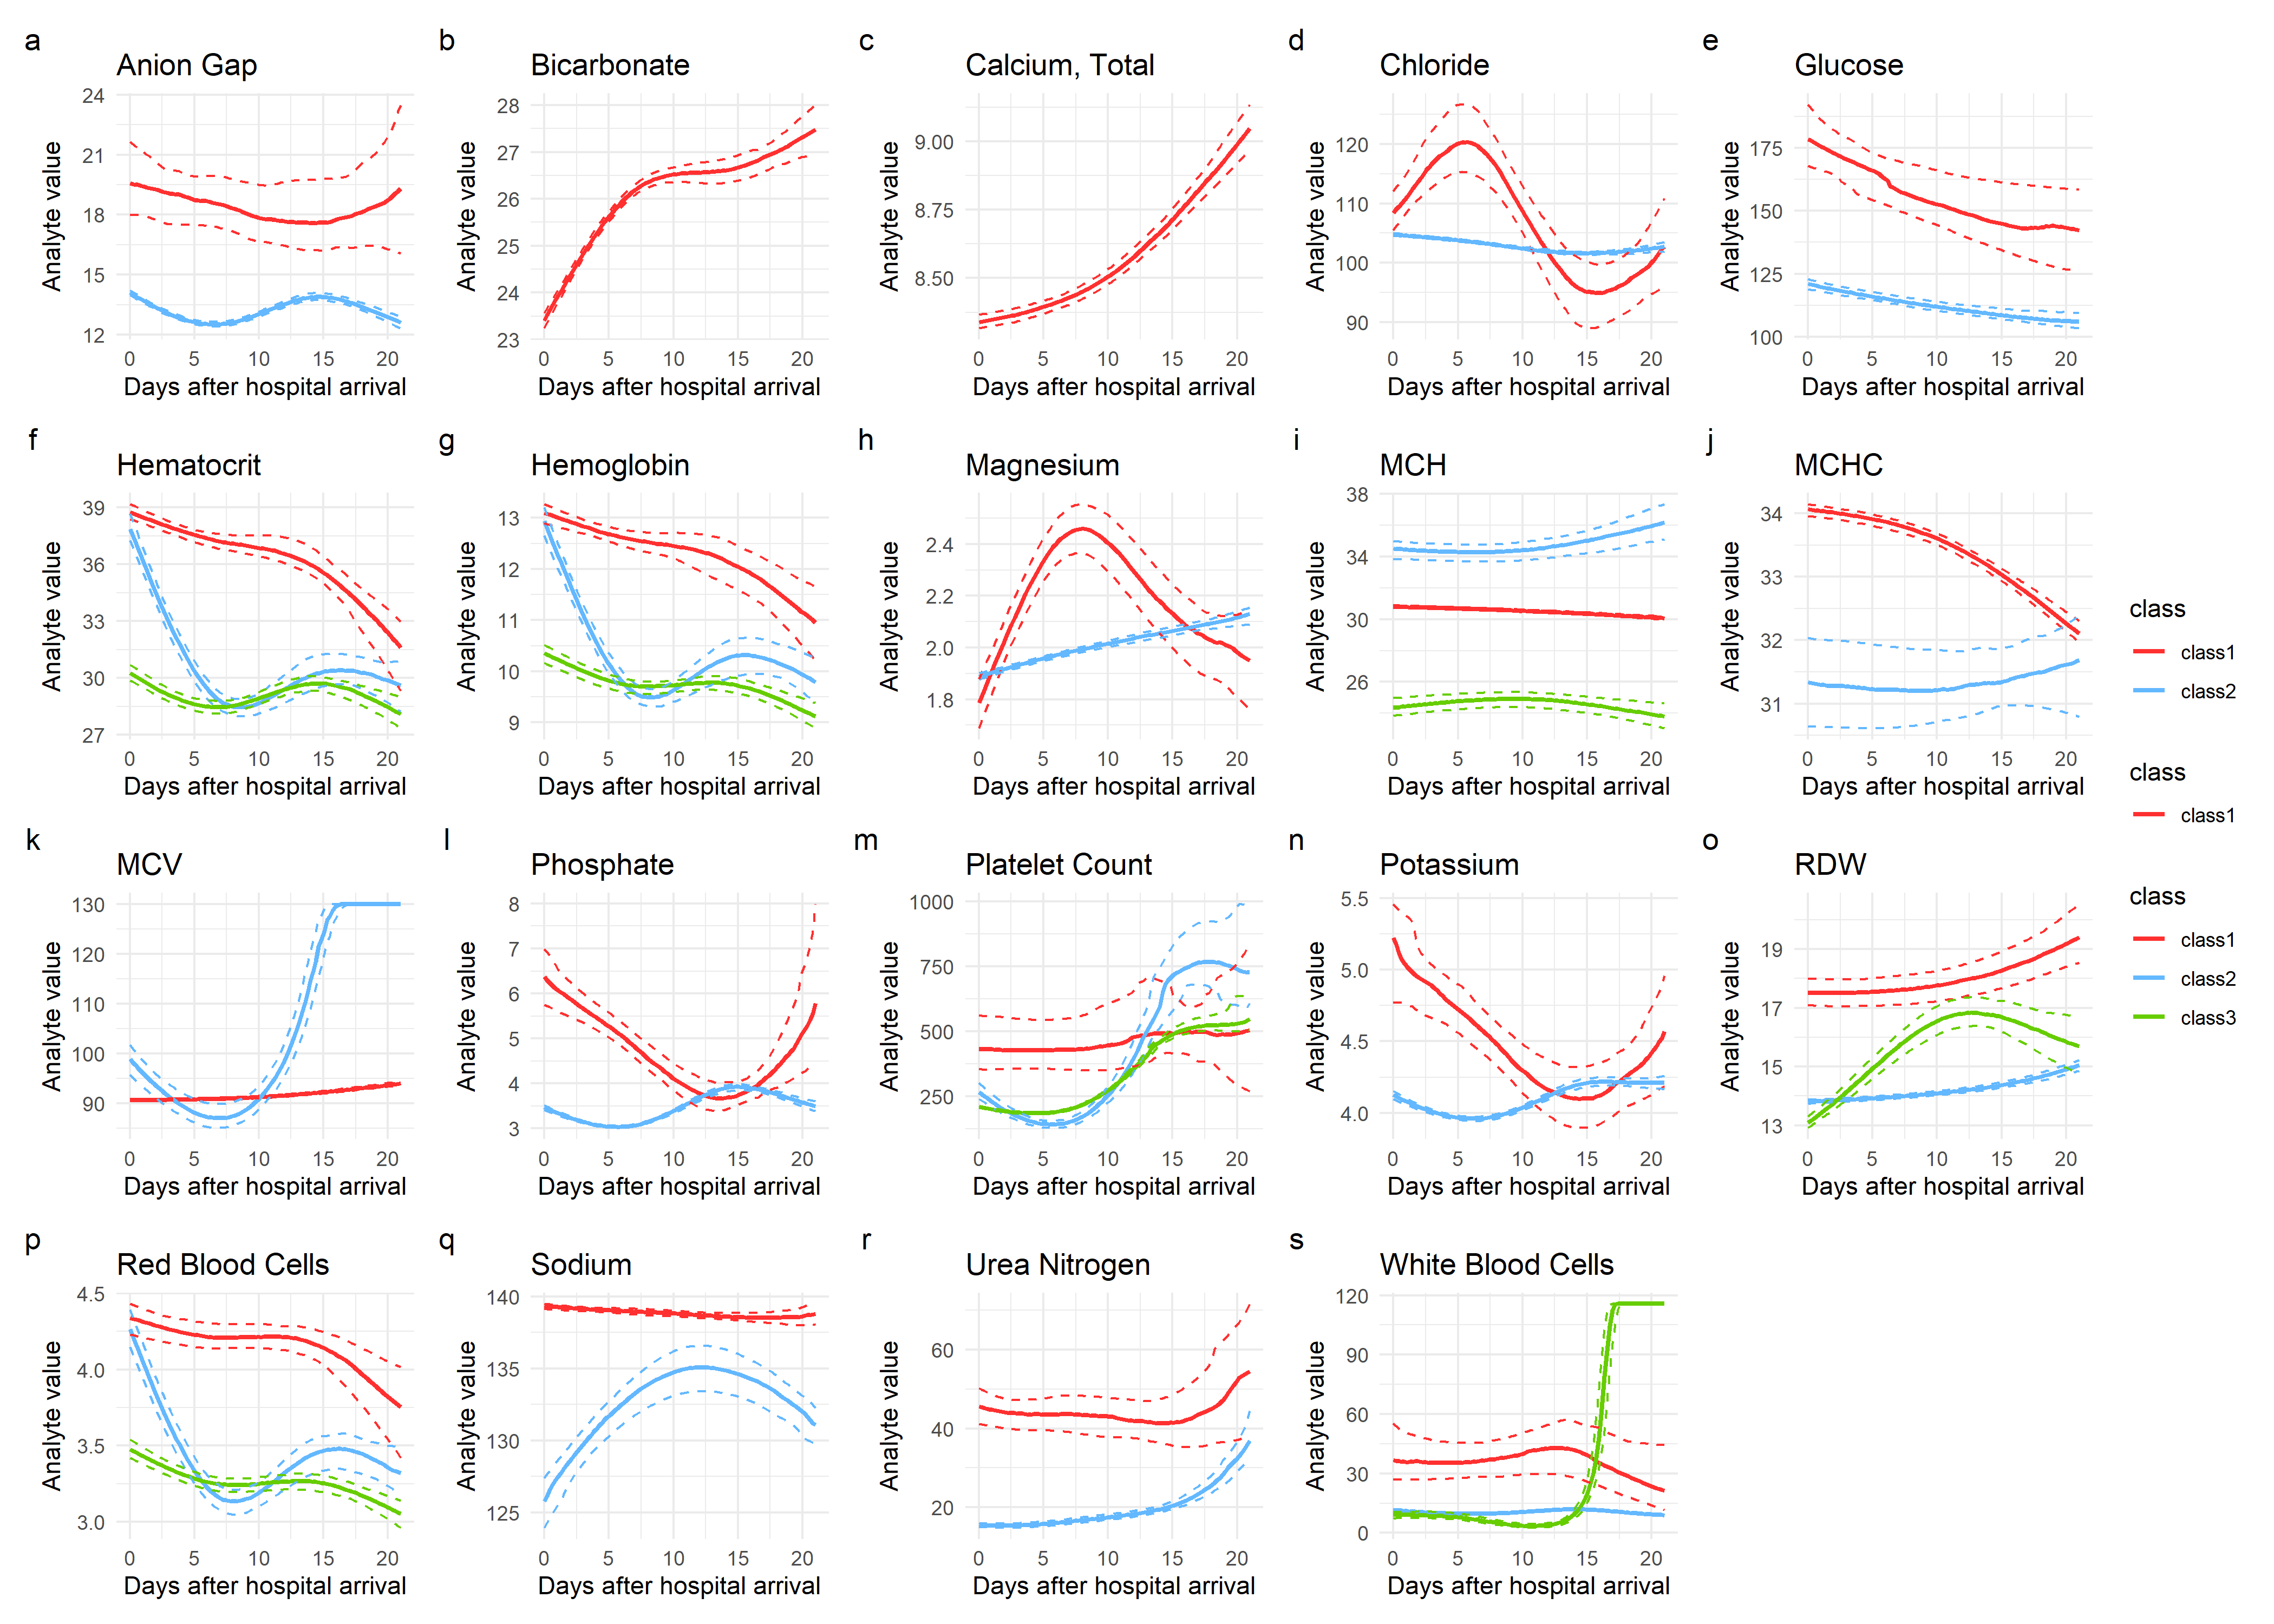
3. Results

Slide 27
3. Results
Chemical markers

Slide 28
3. Results
Chemical markers
Minority class has significant higher in-hospital mortality rate and number of ICD diagnostics

Slide 29
3. Results
Hematological markers

Slide 30
3. Results
Hematological markers
Class 2 is younger, with more males, higher proportion of SCI Fracture patients, higher length of stay and higher in-hospital mortality rate

Slide 31
3. Results
Hematological markers
Class 2 is younger, with more males, higher proportion of SCI Fracture patients, higher length of stay and higher in-hospital mortality rate
Class 3 (vs class 1), higher proportion of females, and higher length of stay

Slide 32
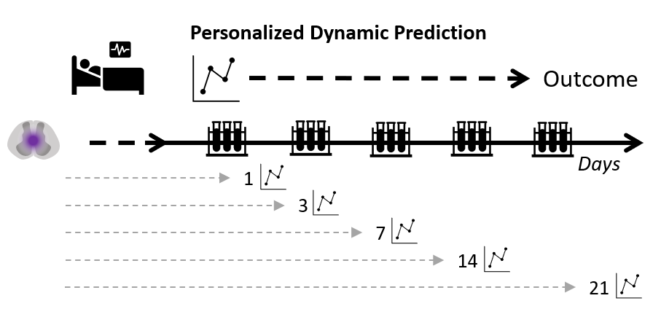
3. Results
Dynamic Prediction Experiments

Slide 33
3. Results
Dynamic Prediction Experiments
Individual subject data
Prediction of trajectory
ML classification
Posterior probability of class membership
Experiment I: in-hospital mortality
Experiment II: Presence of SCI after spine trauma
Experiment III: SCI neurological severity (motor complete vs. incomplete)
E.g.,
Class 1: 0.15
Class 2: 0.8
Class 3: 0.05
Days after hospital arrival
Experiment I and II uses MIMIC data. Experiment III TRACK-SCI, an external SCI cohort
Logistic ElasticNet Model with repeated cross-validation for hyperparameter tuning and estimation of out-of-train sample performance

Slide 34
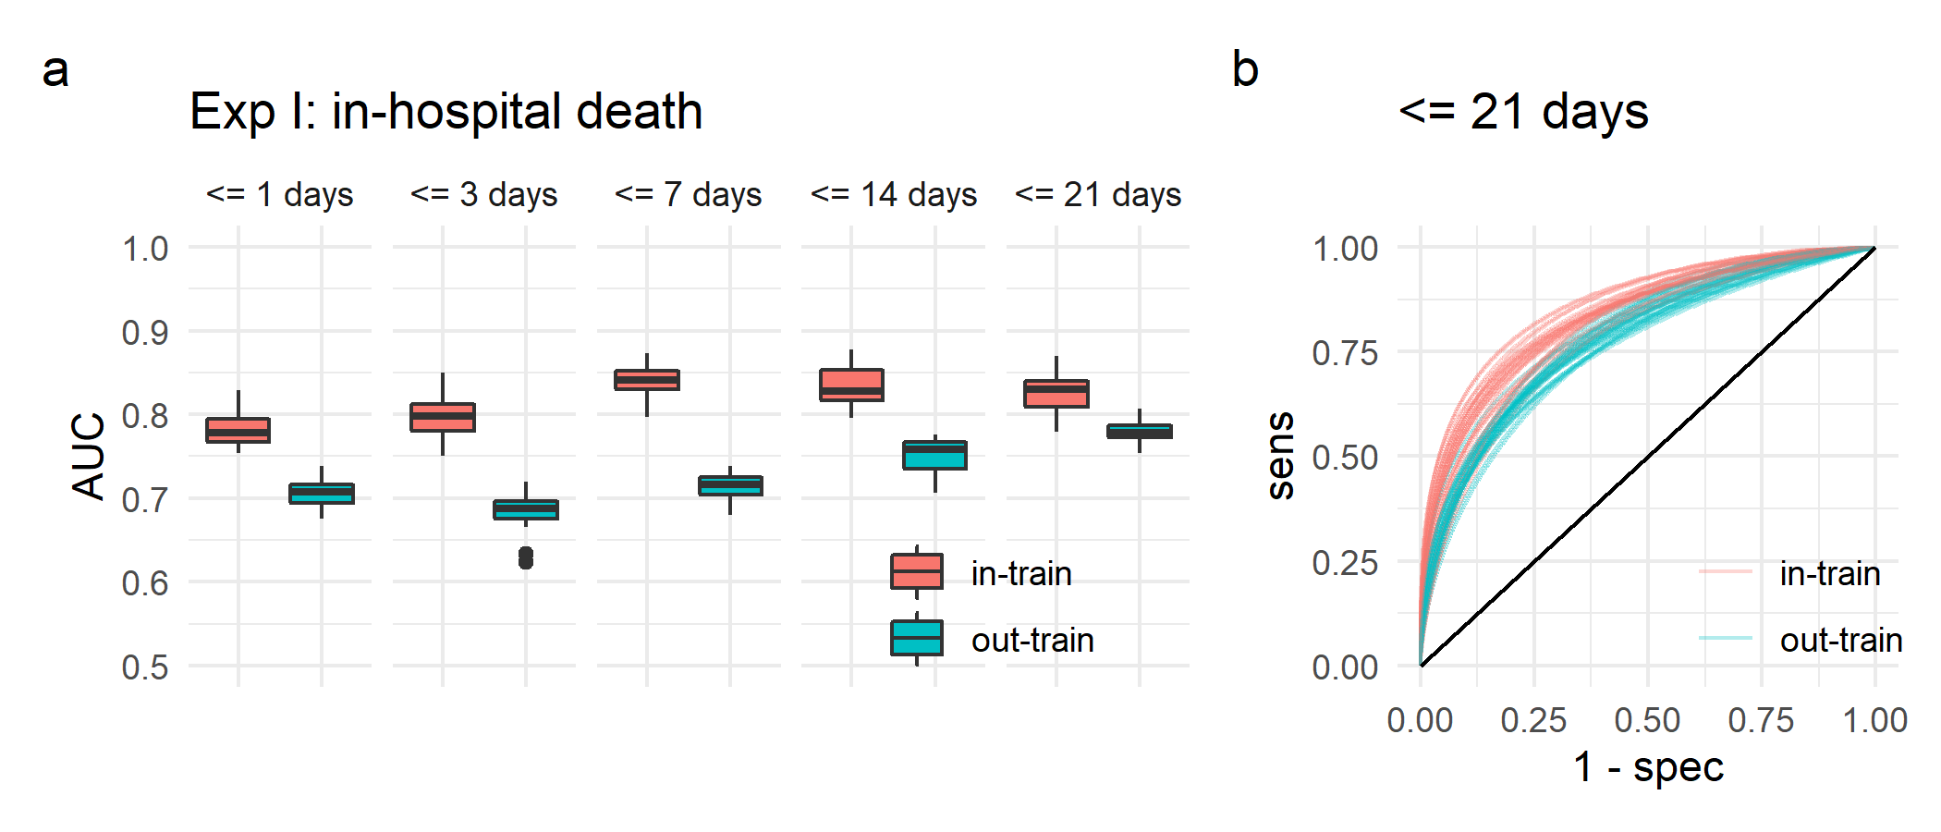
3. Results

Slide 35
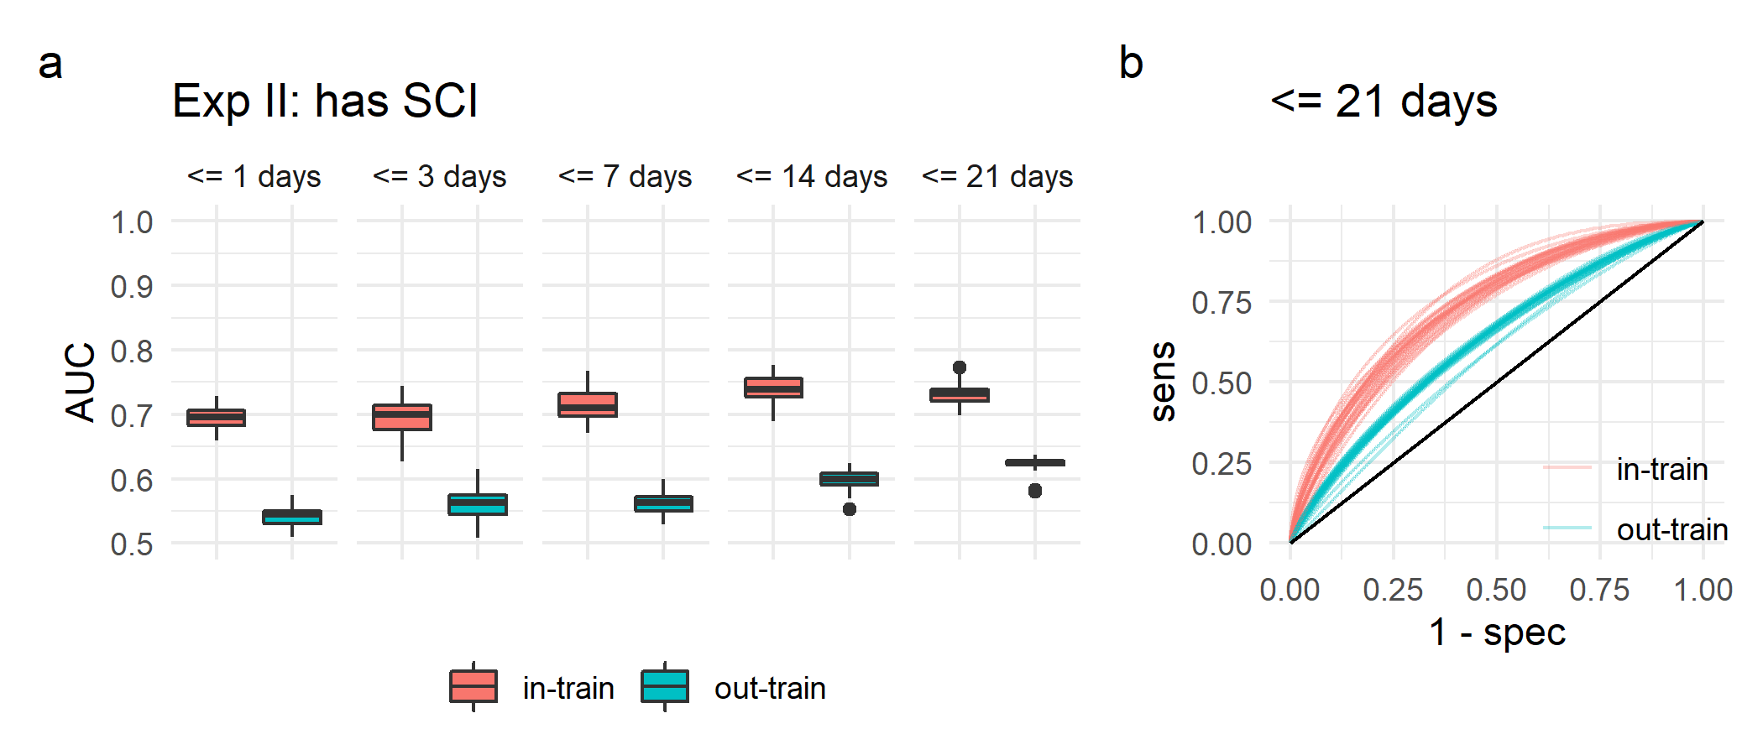
3. Results

Slide 36
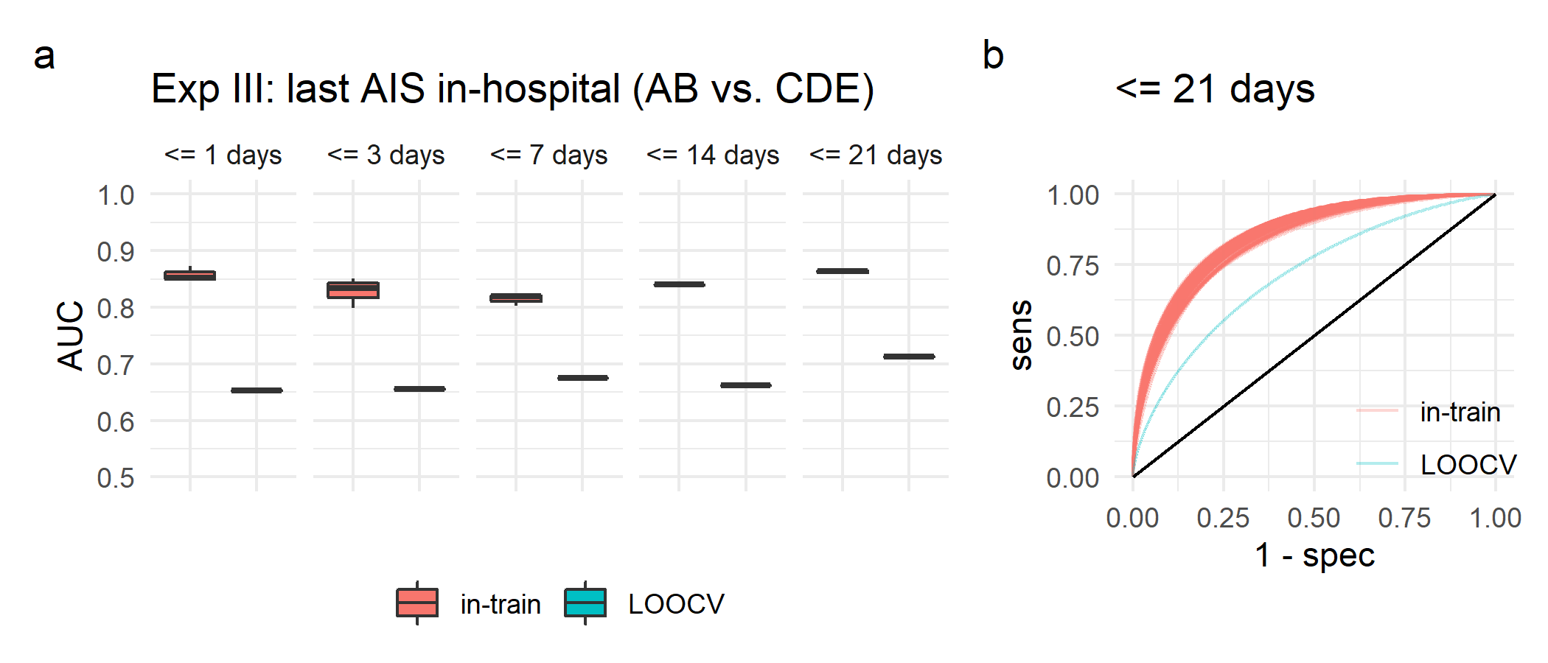
3. Results
Exp III: Motor complete vs. incomplete

Slide 37
4. Conclusions
Longitudinal Finite Mixture Models can be used to model non-linear heterogenous trajectories of blood markers in relation to SCI.
Probability of trajectory membership can be used as features for supervised learning tasks.
Predicted blood trajectory of different blood markers has the potential to be used as dynamic biomarkers for SCI diagnostic and prognostication.
Data from real-world scenarios (e.g., EHR) can be used for SCI research, with potential generalizability to external cohorts.

Slide 38
4. Conclusions
Longitudinal Finite Mixture Models can be used to model non-linear heterogenous trajectories of blood markers in relation to SCI.
Probability of trajectory membership can be used as features for supervised learning tasks.
Predicted blood trajectory of different blood markers has the potential to be used as dynamic biomarkers for SCI diagnostic and prognostication.
Data from real-world scenarios (e.g., EHR) can be used for SCI research, with potential generalizability to external cohorts.

Slide 39
4. Conclusions
Longitudinal Finite Mixture Models can be used to model non-linear heterogenous trajectories of blood markers in relation to SCI.
Probability of trajectory membership can be used as features for supervised learning tasks.
Predicted blood trajectory of different blood markers has the potential to be used as dynamic biomarkers for SCI diagnostic and prognostication.
Data from real-world scenarios (e.g., EHR) can be used for SCI research, with potential generalizability to external cohorts.

Slide 40
4. Conclusions
Longitudinal Finite Mixture Models can be used to model non-linear heterogenous trajectories of blood markers in relation to SCI.
Probability of trajectory membership can be used as features for supervised learning tasks.
Predicted blood trajectory of different blood markers has the potential to be used as dynamic biomarkers for SCI diagnostic and prognostication.
Data from real-world scenarios (e.g., EHR) can be used for SCI research, with potential generalizability to external cohorts.

Slide 41
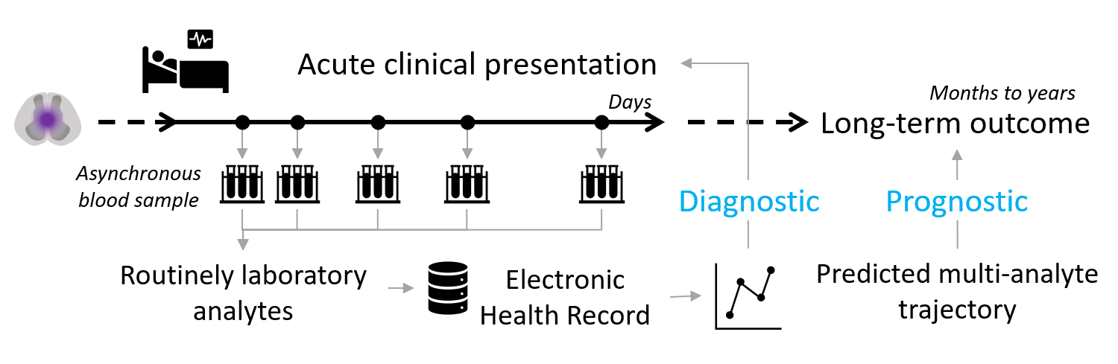
5. Future work
Real-time clinical support system for predicted diagnostic and prognostication

Slide 42
Acknowledgements
Daniel Fernández Martínez
The PhysioNet project
TRACK-SCI team at UCSF

